Slide 1
Foster Parent Diplomacy and Record Keeping
Aug 23, 2025
The Adoption Law Firm

Slide 2

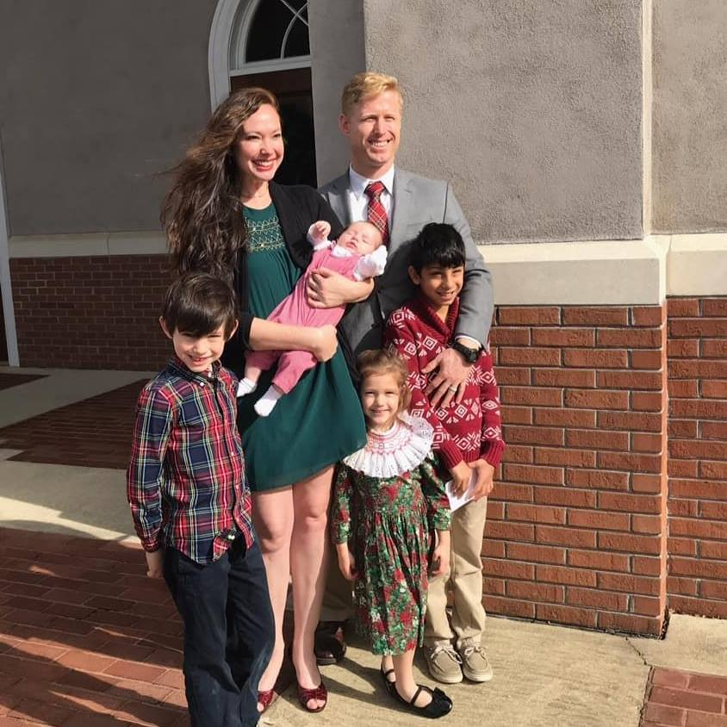
Samuel J. McLure Aug 23, 2025

Slide 3

How to Prepare for an ISP

Slide 4
What is an ISP?
Individualized Service Plans are an ordinary part of every child’s case plan that comes into foster care.
ISP’s are facilitated by the Department and usually take place at the DHR Office

Slide 5

Who is Allowed at the ISP?
Legal parents
Interested parents
Legal parents' attorneys
DHR Case worker
DHR attorney
Guardian ad litem
CASA
Foster Parents attorney

Slide 6
Goals of an ISP
The first thing the foster parent should identify is their goal for the ISP.
01
Each stakeholder will have their own goals for the ISP, so it is best to be prepared.
02
Best practice is for the foster parents to put their goals in writing and distribute that document to all members of the ISP team, this document is called the ISP Agenda Letter.
03
The Agenda Letter should not be longer than one page and usually contain three or less items.
04

Slide 7
Arrival
Plan to arrive at least 20 minutes early for the ISP meeting.
Pass out your ISP Agenda Letter at some point prior to the commencement of the meeting and ask if the team can talk through each point.

Slide 8
Deliberate Demeanor During the ISP
Keep your cool – maintain a calm and gentle demeanor.
The only thing you can do during the ISP meeting is attempt to persuade, so anger will only harm your outcome.
If members do not concede to one of your goals it is okay there are other ways to advocate for your child.
“A soft answer turns away wrath,” and “By patience a ruler is persuaded.”

Slide 9

What to Do if the Result is Unfavorable
If you think the final ISP is unfavorable, you should graciously object.
After you have stated your objections and reasoning to the team, ask the DHR caseworker to let the ISP document reflect your objection.

Slide 10

When the ISP is Over
When the ISP is over the DHR case worker should distribute copies of the final ISP.
Check the content and make sure it is what was agreed or objected to at the ISP.
After the meeting is over follow up with a handwritten thank you note to several team members that made the ISP possible.

Slide 11

Five Tips for Foster Parent Advocacy

Slide 12
1. Expect Push Back
It is possible that since you are not seen as a party in the child’s life the court and those involved will often disregard your input. Even if you are the person best suited for the court to question.

Slide 13

2. Know Your Deadlines

Slide 14
Relative Placement and TPR
The court is required to consider placing the child with relatives, as an alternative to termination of parental rights.

Slide 15
#1
  If a parent has abandoned their child for four months, the juvenile court is not required to consider placing the child with a relative.

Slide 16
#2
  If a relative is given notice of the child being in foster care, and does not come forward in four months, the juvenile court is not required to consider them for placement.

Slide 17
#3
  If the child has been in foster care for twelve of the last twenty-four months, the Department is required to file a petition to terminate the legal parents’ rights. There are a few expedient exceptions to that rule.

Slide 18
#4
  After a petition for TPR has been filed, the next checkpoint is serving all parties. This means the legal parents. After all parties have been served the court has ninety days to complete the trial on TPR.

Slide 19
#5
After the juvenile court completes the TPR trial, they have thirty days to issue their order on whether termination should take place.

Slide 20

3. Prepare in Advance
It doesn’t matter if your foster child has been in your home for three weeks or three years, documentation is the starting point for your advocacy.
Notes:
For each of these deadlines, there is a tremendous amount of value a foster parent can add to the advocacy equation. Many cases have turned on foster parents being prepared ahead of time to advocate for their children.
At the foundation of every prepare-in-advance strategy is documentation. An old proverb sums it up this way: “You can’t stop crazy, but you can document it.”

Slide 21

4. Know Your Options

Slide 22

The Legislative Branch
Notes:
Under the legislative branch, your options are limited to creating and lobbying for changes to statutes that affect your foster child’s situation. This option almost never provides the immediate and time sensitive relief that your foster child needs. However, you can play a lead role in promoting good legislation that solves or improves repeat problems.

Slide 23

The Executive Branch
Notes:
Advocacy for your foster child under the executive branch includes attending ISPs, preparing for and advocating for your foster child’s best interest at ISPs, diplomacy with the DHR case worker, working up the Department’s chain of command when problems arise, and initiating the Department’s conflict resolution process.

Slide 24

The Judicial Branch
Notes:
Under the judicial branch, you have a lot more options. You can ask the Court to let you become a party to the current case before the Court. The formal name for this request is called “Intervention” and in most cases the current case before the court is “dependency.” Whether a judge grants or denies a foster parents’ request to be a party to the current case is within the discretion of the court – as things currently stand.

Slide 25
Foster Parents Right to Petition
Foster parents can also petition for custody of their foster child.
On the same note, foster parents can petition for termination of the child’s parental rights.
Notes:
There is a common and sad misconception that foster parents will violate their foster parent agreement with the Department if they hire an attorney and petition for custody of the child in their care. This just isn’t true.
A little-known fact is that the Department is required by law to join the foster parents’ petition for termination, unless the Department has documented some really good reasons not to.

Slide 26
5. Foster Parent Intervention Aids Reunification
Foster parent intervention is not just useful to achieve permanency through adoption. It also can assist reunification in a way that is as gentle as possible to the foster children.
Notes:
Reunification is the first and most important goal of foster care. When it is timely pursued and in the best interest of your foster child, the foster parents can have a great impact on the child’s transition for the better.
Being transition well means that the Department is following their own policy and best practice. The best practice for transition a child is gradual over time – and tailored for the individual circumstances.
Many foster parents are hopeful about a bio family member, but they want to make sure that the children are transitioned well.
As a side note, it’s almost always clinically prescribed that the first visits with the relative happen in the presence of the long-time foster parent. This creates a safe place for your foster child to gradually become accustomed to the relative caregiver.
Sometimes, this type of healthy transition can only happen if the foster parent intervenes to become a party to the case.

Slide 27
The Transition
Transitioning well also means that the natural parents or relative caregivers have as much knowledge about their children as possible. Foster parents have the best information about every aspect of their foster child’s life. Ideally, all of this would be shared as part of the transition process.
The sad reality is that many children are transitioned without the benefit of this full sharing of information. Unless a foster parent is a party to the case, they have no recourse to petition the Court to mandate that their foster child transitions well.
Notes:
Perhaps the foster parent could even create a notebook with all of this relevant information. Ideally, this information would be fluidly shared with the legal parent or relative caregiver.

Slide 28

A Voice
Foster parents should be part of the conversation regardless of whether they support or oppose reunification. It is always in the child’s best interests for the Court to hear from foster parents. The only way any person is guaranteed to have a voice in court is if they are a party.
Notes:
For the sake of the children and the natural families they will reunite into, foster parents must have a seat at the table as parties to the juvenile court case.

Slide 29

”Once Upon A Time, Timmy Changed A Judge’s Mind"
As appeared in Alabama Lawyer, [The Adoption Issue] [May 2022 Volume 83, number 3]

